Slide 1
Lecture 4

Slide 2
Real Numbers (Float Point Number)
A float point number f
f = m * b^{e}, where m = mantissa, b = base, e = exponent
Ex. (13.25)₁₀ = (0.1325:m) * (10^{2=e}:b)
(0.001325)₁₀ = 0.1325 * 10⁻²
Biased Exponent
Assume that a number is represented in m-bits. Then
0 =< number =< 2^{m} – 1
Special case: m = 4
0 =< number =< 2^{m} – 1 = 2⁴ – 1 = 15
0 =< number =< 15
Then, the bias B = 2^{m-1}
Then , the system can represent numbers in the range
-B =< numbers =< N – B , where N = 2^{m} – 1
If we shift one bit to the left
B = 2^{m-1} = 2⁴⁻¹ = 2³ = 8 //table 1.6 p. 28

Slide 3
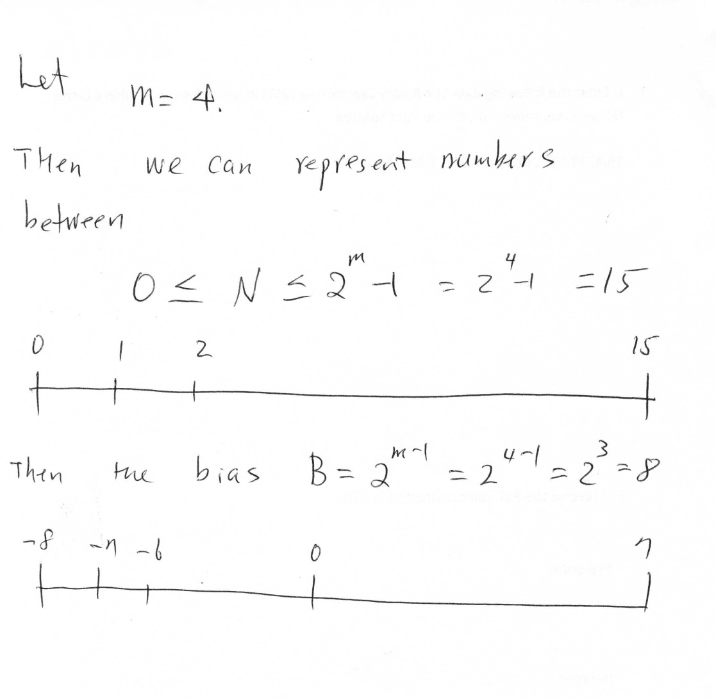
Biased Exponent

Slide 4
IEEE Floating Point Format
Where S = signed bit = (0 if number if positive OR 1 if number is negative)
E (exponent) = B + Actual exponent, where B = 127
1 =< F < 2
A floating point number
x = (-1)^{S} * 2E * 1.F //check fig 1.6 – 1.7 p. 28-29
Ex. Represent -( 2345.125)₁₀ in IEEE Floating Format
-(2345.125)₁₀ = -(100100101001.001)₂
The sign bit is negative → S = 1
E = B + Actual exponent. Remember B = 127
Actual exponent is determined by how many digits we move the decimal, so – (1.00100101001001)₂ gives us actual exponent of 11
E = 127 + 11 = (138)₁₀ = (10001010)₂
F = the digits after the decimal point + add zeros until you reach 23 bits
F = 00100101001001000000000
Total of 32 bits. Sign bit + 8 bits for Exponent + 23 bits for Fraction
S | E | F
1 | 1000 1010 | 00100101001001000000000

Slide 5
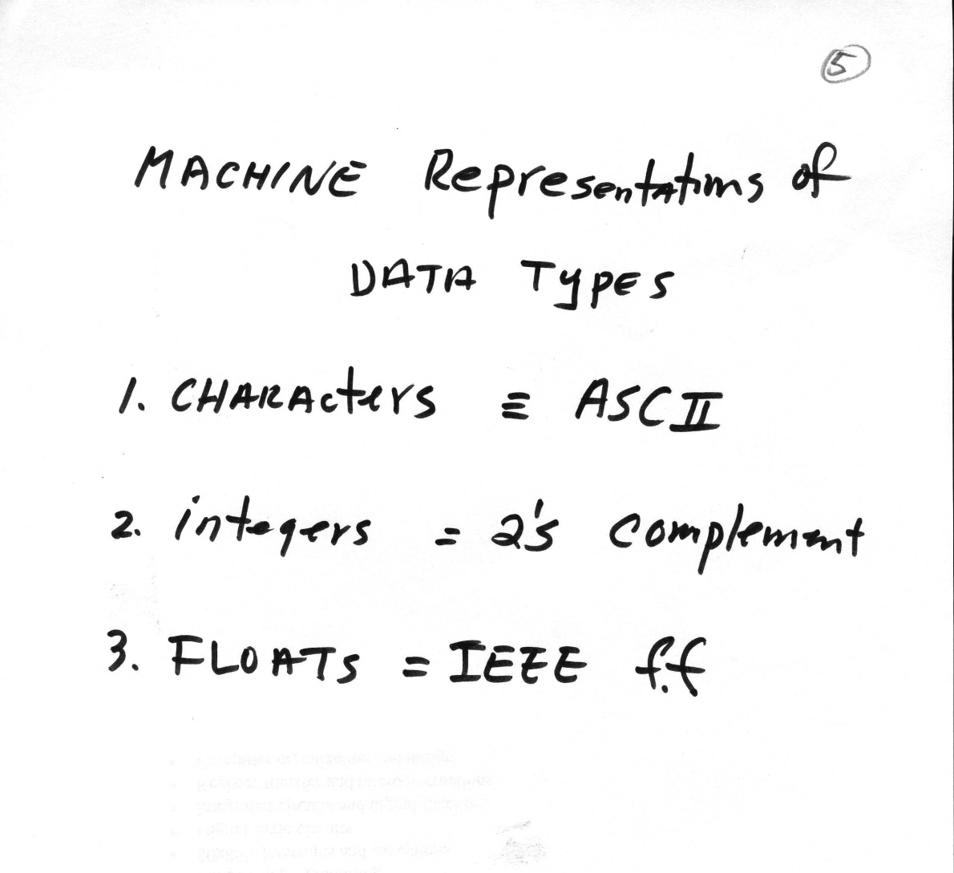
The summary

Slide 6
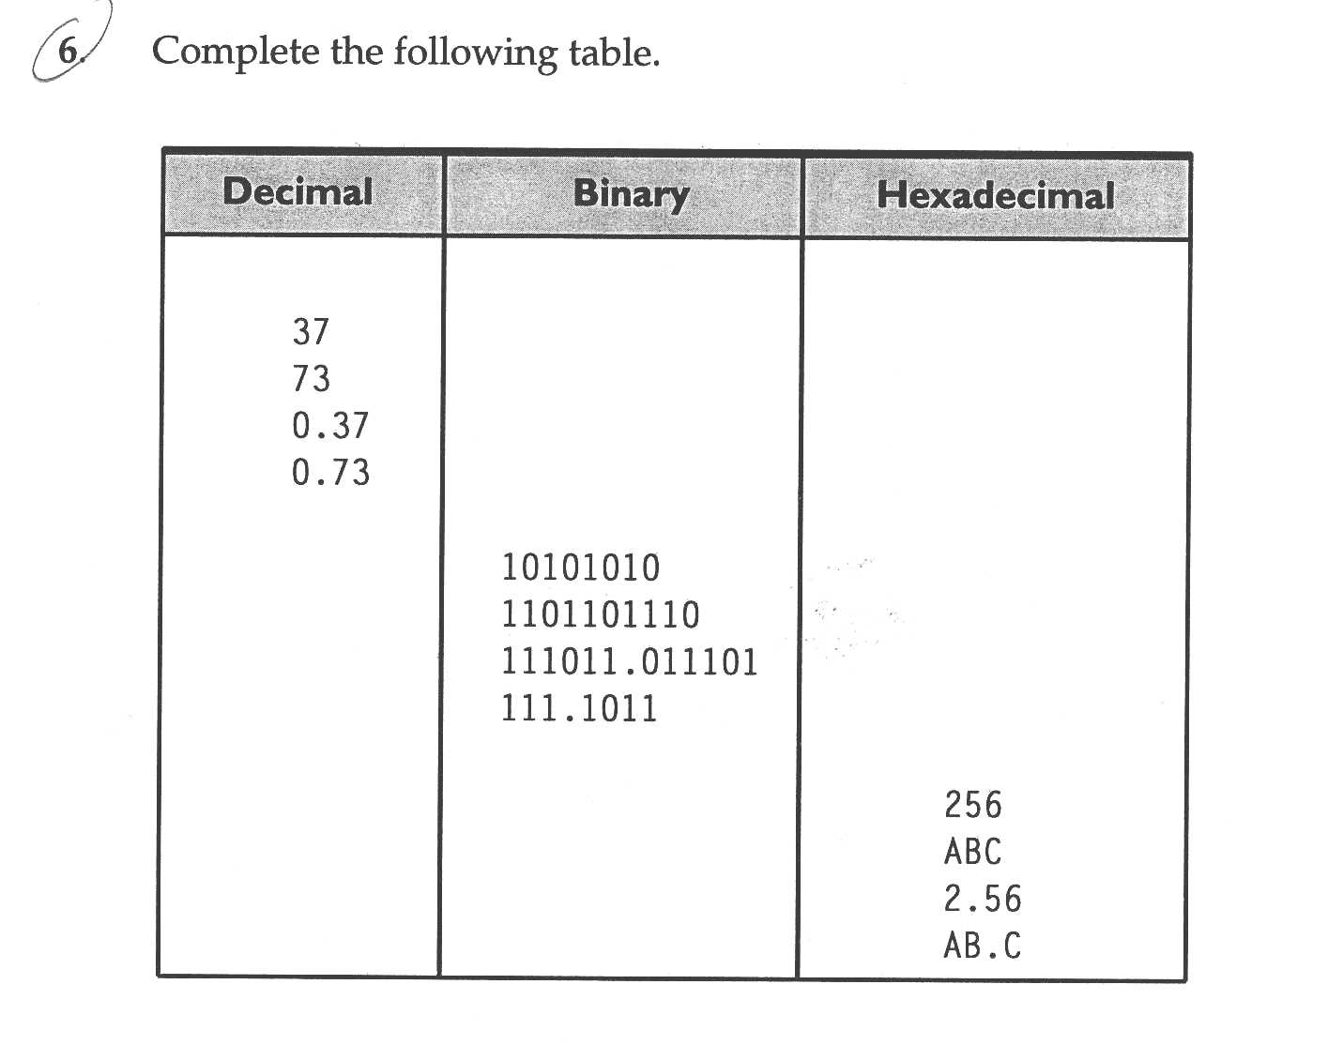
Homework 1

Slide 7
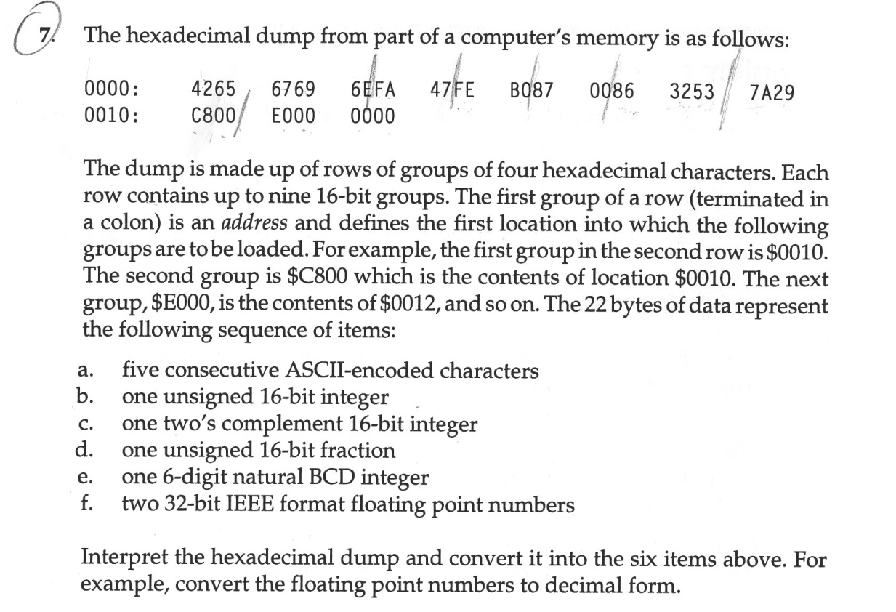
Homework 2

Slide 8
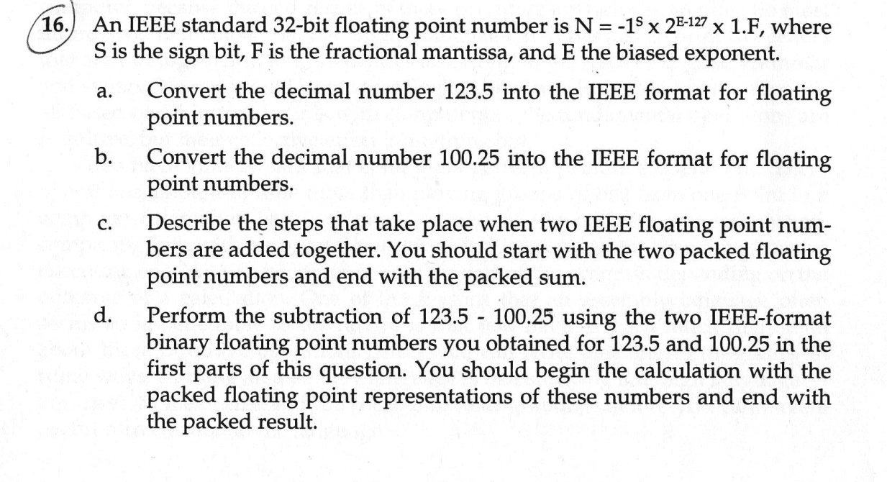
Homework # 3

